Slide 1
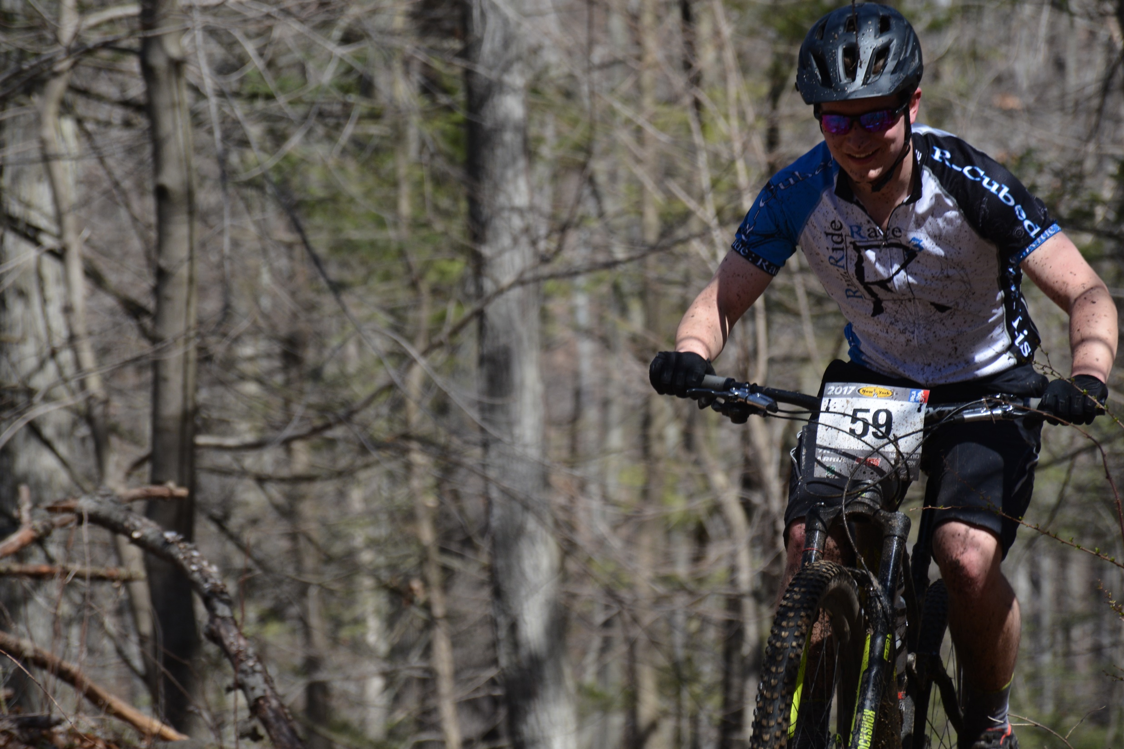
2019
R-Cubed NICA Composite
Team

Slide 2
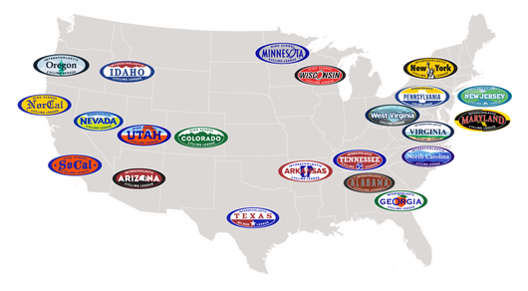
The NICA League
21 states have leagues across the US
Founded in 2009, the National Interscholastic Cycling Association (“NICA”) develops interscholastic mountain biking programs for student-athletes across the United States. NICA provides leadership, services and governance for regional leagues to produce quality mountain bike events, and supports every student-athlete in the development of strong body, strong mind and strong character through interscholastic cycling.

Slide 3
NICA NY
27 teams from throughout NYS
Holds 5 spring season cross country mountain bike races
First race is in the beginning of April, finale is early June
Races distance vary based on age but general range from 10-15 miles or 45min to 1.5 hours.
Races are held Sundays. Courses are set up Saturday morning giving you the opportunity to pre-ride the course Saturday afternoon if you wish
Races generally within a 2.5 hour drive from Albany
Some families choose to stay overnight in a hotel, but all are drivable the morning of.
Parents are encouraged to volunteer to help our at the races if they wish!
R-Cubed’s 5th season in the NICA league
2017 Championship Recap:
https://www.youtube.com/watch?v=Qqs3KvNdSmE

Slide 4
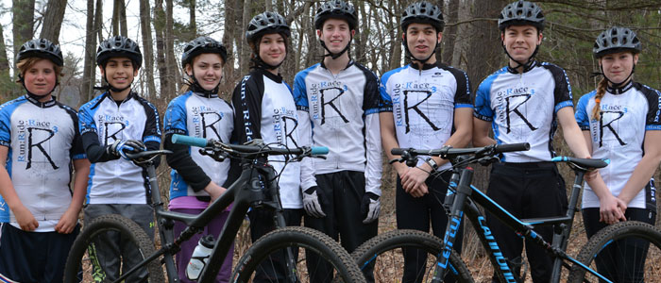
What is R-Cubed?
R-Cubed was brought about on the simple idea of riding your bike with your friends….no qualification times, no essays… just a bike and a smile!
Group of riders who wanted to get together to ride bikes and have fun!
Hold Casual/fun rides throughout the year
Attend races as a team to race hang out and have fun while riding bikes!
Everyone is welcome to join, no experience necessary. We have rider from beginners through semi-pros

Slide 5
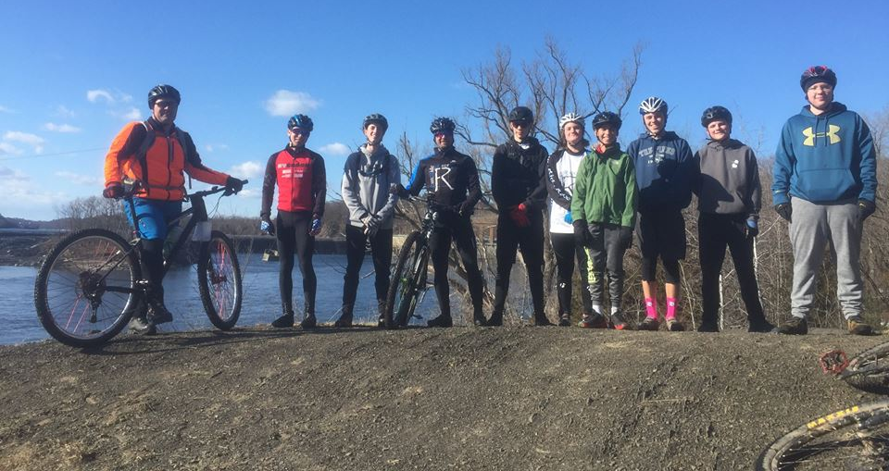
Why Join R-Cubed NICA?
Coaches are also racers
They have the experience and knowledge to help you achieve your goals
Fun/Encouraging atmosphere at races and practices
Workout plans tailored to help riders achieve their goals and prepare them for the NICA races
You want to challenge yourself while riding your bicycle!

Slide 6
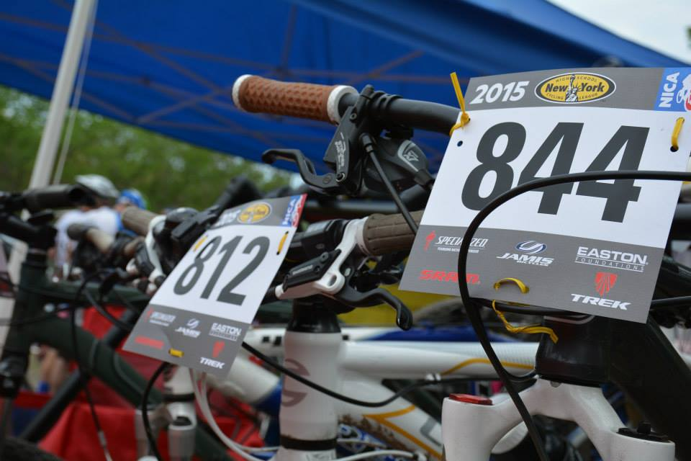
Coaches
Rich Tortorici
Kim Milton (Head Coach)
David Taylor
Frank Winters

Slide 7
2 Levels of involvement for R-Cubed
NICA Team Rider/ Adventure Rider
Want to ride with a team but do not wish to race yet
Build MTB skills
Attends team Practices
NICA Team Racer
Want to compete against others in the NICA races
Want to challenge yourself
Attends team practices
*Student Athlete can move her/him-self to wherever they are comfortable anytime throughout the year.

Slide 8
R-Cubed Composite NICA team
Motivated and driven riders who are excited about challenging themselves
Made up of Middle and high school riders from all round the the capital district
Burnt Hills, Colonie, Waldorf School, Saratoga Springs Etc.
We welcome any high school and middle school student regardless of mountain biking experience.
Emphasis is on rider skills development, athletic development, nutrition, teamwork and fun.
Practices are designed around preparing riders for the 5 NICA league races
Races beginning in Early April and are not mandatory
Season begins January 1st and ends Mid-June.
NO ONE IS EXCLUDED!! Everyone rides for the team!

Slide 9
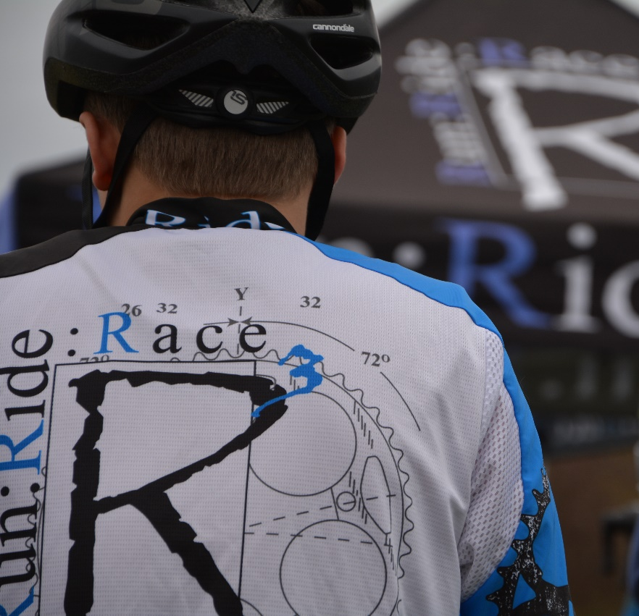
R-Cubed NICA Adventure Rider
Great for riders who are just getting into the sport and are not ready to race yet.
Riders who want to improve skills and have a good time riding with friends.
Excellent choice for students who just want to have fun riding bikes and enjoying nature.
Have fun without the pressure of competition

Slide 10
Which group is right for me?
Team Adventure Rider
NICA Race Team
Riders of all levels who want to learn what Mountain biking is all about and have fun riding with a group without the pressure of racing.
Volunteers lead rides
Fun rides designed for skills building and enjoyment
Seasonal rides
Riders of all levels who would like to challenge themselves, have fun and Race
NICA membership fee, races fees, team dues and jersey
Certified coaches lead practices
Fun Practices – designed to prepare riders for the 5 NICA races and beyond
Winter spin sessions
Advanced Coaching available

Slide 11
2019 New York NICA Race Schedule
Race Season
04/14/19 - Pinewood XC Cathedral Pines Long Island
04/28/19 - Timber Ridge XC Walnut Mountain, Liberty
05/05/19 - The ADK XC Gurney Lane, Queensbury
05/19/19 - Clark Sports Center XC Clark Sport Center, Otsego
06/02/19 - Windham Mountain Championship
Windham Ski Mountain, Windham
Rain Date For Any Cancelled Race June 9th

Slide 12
Example Race details
Category Start Time Laps Approx. Distance
WAVE 1
Freshman Boys 9:30am 10mi
Freshman Girls 9:34am 10mi
MS 8th Grade Boys 9:40am 10.5mi
MS 7th Grade Boys 9:43am 10.5mi
MS 6th Grade Boys 9:46am 10.5mi
MS Girls 9:49am 10.5mi
WAVE 2
Varsity Boys 11:30am 15mi
JV Boys 11:33am 15mi
Sophomore Boys 11:36am 15mi
Varsity Girls 11:39am 15mi
JV Girls 11:42am 15mi
Sophomore Girls 11:45am 15mi
Podium/awards to top 5 in each race
Races will last about 45min – 1.5 hours depending on category

Slide 13
2018 NICA NY Team Results
1 Niskayuna High School
2 Otsego Composite
3 R-Cubed Composite
4 Pleasantville
5 Bronxville High School
6 Mohawks
7 Chenango Composite
8 NYCranks Composite
9 Punx of the Gunx
10 Briarcliff Climbers
11 Galena Growlers Composite
12 Long Island Hurricanes
13 Grey Ghost Bicycles
14 Fayetteville Manlius
15 Blue Mountain Reservation Composite
16 Independent Riders
17 Hudson Hawks
18 Watervile Mountain Bike
19 Endless Trails Composite
20 The Storm King School
21 b.i.k.e.-Syracuse
22 Catskill Claws Composite
23 Brands Cuevas Junior
24 Rivertowns Racing Composite
25 Arlington High School
26 East End Composite
27 Montauk Mountain Bike Team

Slide 14
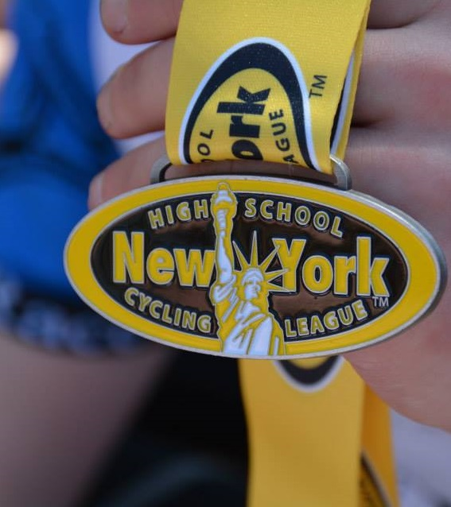
2018 R-Cubed Composite Highlights
11 High School Riders
7 middle school Riders
3rd place overall team out of 27 teams
Connor Singh 1st overall Varsity Boys winner
Erin Smith 1st overall 6th Grade Girls winner
Multiple podium finishes across the team

Slide 15
2019 Season Plan
Season Begins December 1st
Winter practices:
Outside practices if weather holds out in December
Wednesday Spin in Clifton Park
R-cubed coaches can bring trainers if you need one, or you can sign a trainer out for the season
You bring your bike
Spring Practices
Will be held 2-3 practices a week in parks across the capital district including:
North Bethlehem Town Park
Colonie town Park
Luther forest – Malta
Pine Bush Preserve
Gurney Lane – Queensbury
Schenectady Central park
Thacher state park
Supplemental workout plan will be provided for days there is no team practice or unable to attend practice.

Slide 16
What is a practice like?
Practices are not mandatory
The more effort you put in, the better results you will get!
2 practices a week on weeknights, sometimes we will hold a weekend practice
Lasts 1.5-2 hours, 6:00pm - 7:30pm/8:00pm
Riding – Mostly single track riding, focusing on NICA level race courses
Technical skills – Cornering, log overs, rocks, riding technical sections
Racing skills – Starts, passing, feed zone, trail etiquette, line choice
Games!
Bike maintenance lessons
Stretching/Core workouts

Slide 17
Costs – NICA Team
NICA team Rider (Non-Racers and Red shirts)
NICA Registration /waiver
Team Dues - $25 (Payable when rider has decided to join the club)
NICA team Racer
NICA Registration fee - $35
Team Dues - $50
Team Jersey (one time purchase) - $70
Race Fees (per race) - $35
Race Fees – Goes directly to NICA Race promotor
NICA registration fee – Goes directly to NICA
Team dues
Covers team NICA fees/coaching licensing fees,
maintenance on team bikes and food from our sponsors*

Slide 18
Thank you to our Sponsors

Slide 19
Pitzone
First step to Joining R-Cubed NICA team is to Join Pitzone
Send us your email and we will send you an invite to register and join the team.
Pitzone is a portal for forms and race registration
All Students interested in participating in the NICA team must register in pitzone before attending any practices. NICA
https://pitzone.nationalmtb.org/

Slide 20
Contact
RCubedNICA@gmail.com
Dot not txt individual coaches, please use the email as all coaches have access to it.
https://www.facebook.com/rcubedcomposite
http://www.RCubednica.com

